Slide 1
Computing Paradigm
Cloud
Computing
Lecturer: Truong Thi Ngoc Phuong

Slide 2
Learning objectives
Give a brief description of major of computing
Examine at the potential of these paradigms
For more info: phuongttn@hcmute.edu.vn | FIT@UTE | FAQS
You can visit our sister projects: FB Group |

Slide 3
Table of contents
01
02
03
04
High Performance Computing
Parallel Computing
Distributed Computing
Cluster Computing
05
06
07
08
Grid Computing
Cloud Computing
Mobile Computing
Network Computing

Slide 4
01
High Performance Computing
2022

Slide 5
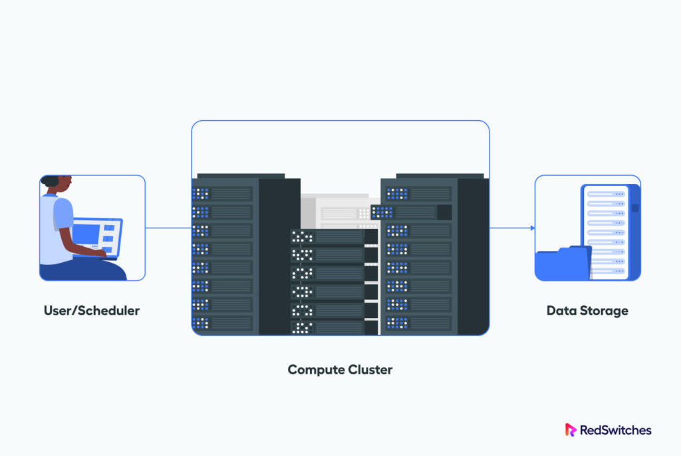
Introduction
A pool of processors (CPUs) connected with other resources like memory, storage, input and output devices
The deployed software is enabled to run sequential or parallel in the entire system of connected components.
Processor machines can be of homogeneous or heterogeneous type. .

Slide 6
High Performance Computing
Characteristics
Speed
On-premise or Cloud Deployment
Fast Calculation
Compute resources can be scaled up or down as necessary.
Some cloud providers also allow users to choose CPUs that suit the requirements of a particular project.
Cost
Cheaper than supercomputing
Flexibility and Efficiency
Workload can be scaled up or down depending on need.
With a robust internet connection, HPC can be accessed from anywhere on the globe.
Fault - Tolerance
If part of the system fails, the entire HPC system doesn’t fail
Notes:
workloads can be scaled up or down depending on need. With a robust internet connection, HPC can be accessed from anywhere on the globe.

Slide 7
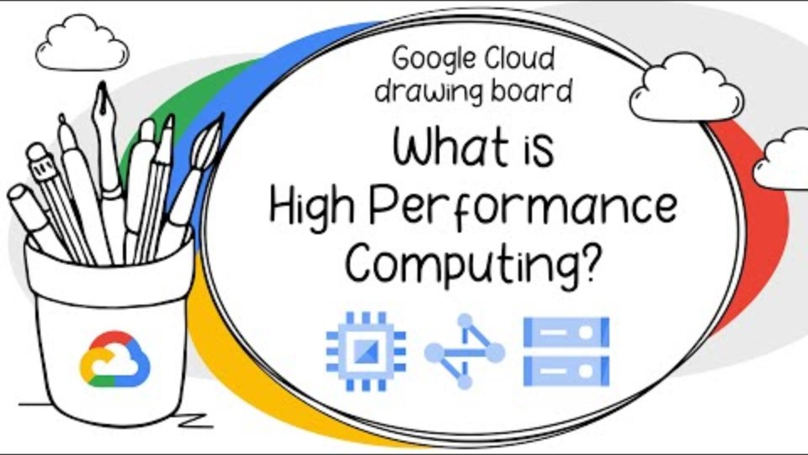
Computing

Slide 8
02
Parallel Computing
2022

Slide 9
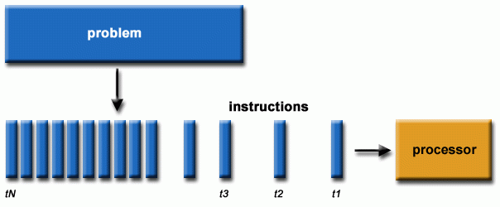
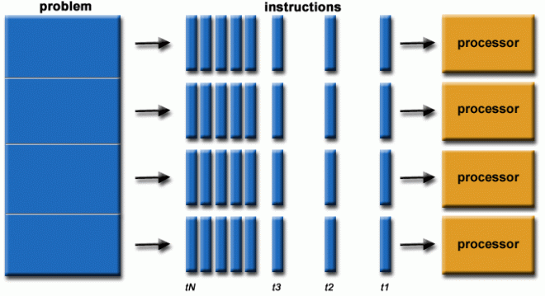
Introduction
One of the facets of HPC.
Set of homogeneous processors work cooperatively to solve a computational problem. .

Slide 10
Parallel Computing
Characteristics
Cost
Ultilization
It saves time and money as many resources working together will reduce the time and cut potential costs.
It can take advantage of non-local resources when the local resources are finite.
Concurrency
Efficiency
Improve performance.
Multiple execution units, pipelined instructions, multi-core.
It can be impractical to solve larger problems on Serial Computing.
Notes:
workloads can be scaled up or down depending on need. With a robust internet connection, HPC can be accessed from anywhere on the globe.

Slide 11
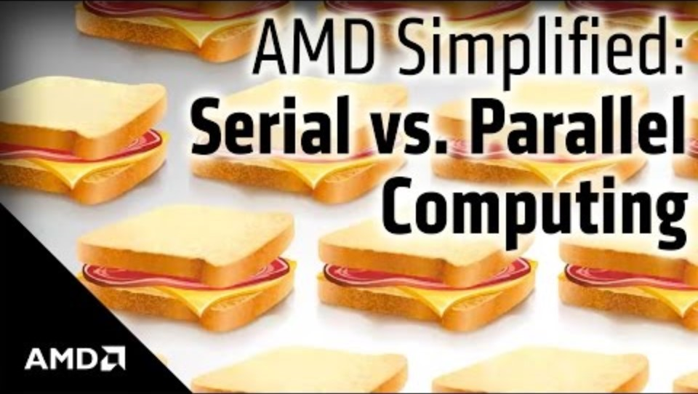
Computing

Slide 12
Read More….
https://hpc.llnl.gov/documentation/tutorials/introduction-parallel-computing-tutorial

Slide 13
03
Distributed Computing
2022

Slide 14
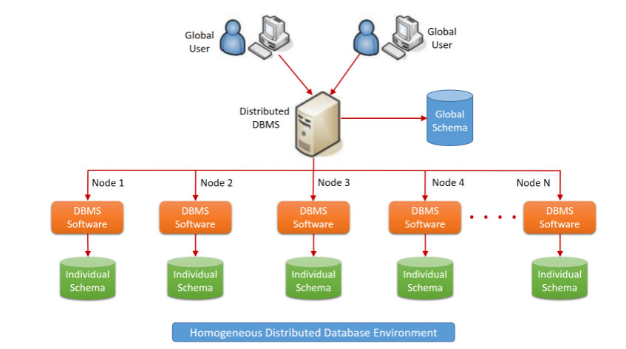
Introduction
Multiple computers or processor machines connected through a homogeneous or heterogeneous network. .
Connectivity can be local network or geographical distance or wide area network.
The goal of distributed computing is to make such a network works as a single computer.

Slide 15
Distributed computing
Characteristics
No shared clock
Concurrency
Order events – logical clock is achieved by synchronization/coordination.
tasks are executed concurrently.
Heterogeneity and Loose coupling
No shared memory
State is distributed through the system.
not required – different Oss and technologies.
Redundancy or replication
Scalability
several machines can provide the same service → if one is unavailable, work does not stop..
be easily expanded by adding more machines as needed without affecting the existing setup.
Notes:
workloads can be scaled up or down depending on need. With a robust internet connection, HPC can be accessed from anywhere on the globe.

Slide 16
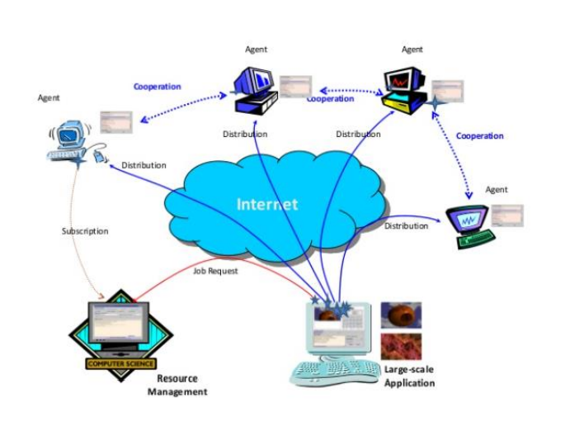
Distributed Computing
Architecture
Agents
Use free sources for their own computations.
Divide large processing tasks into smaller tasks. - Runs on individual agents. - Monitor status of the jobs run by the clients
Server
Take distributed computing requests
Divide large processing tasks into smaller tasks.
Runs on individual agents. - Monitor status of the jobs run by the clients
Notes:
workloads can be scaled up or down depending on need. With a robust internet connection, HPC can be accessed from anywhere on the globe.

Slide 17
Types of Distributed Computing
Distributed Computing
Distributed Computing System
Distributed Information System
Distributed Pervasive System
Grid Computing
Cluster Computing
Cloud computing
Same as ubiquitous computing

Slide 18
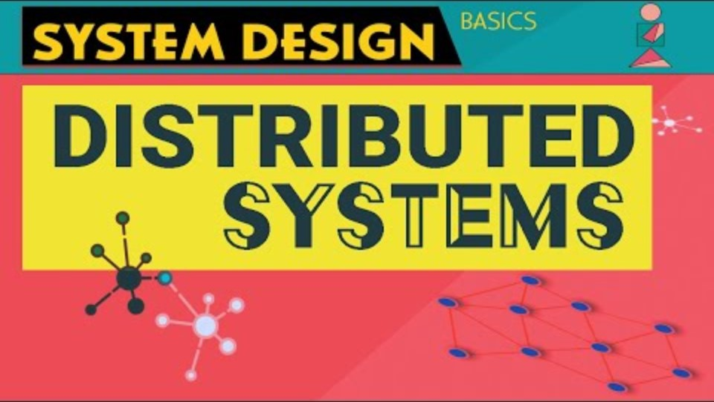
Computing

Slide 19
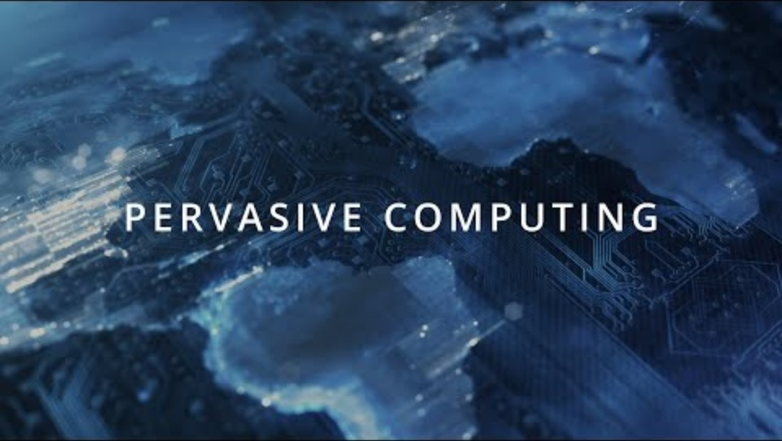
Computing

Slide 20
04
Cluster Computing
2022

Slide 21
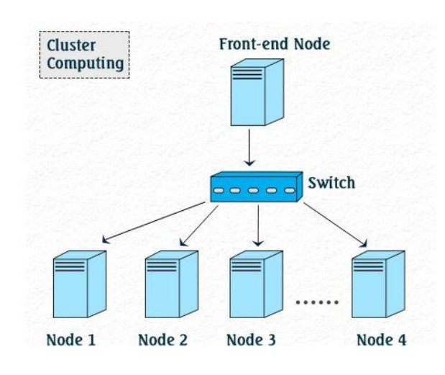
Introduction
Set of the same type of processor machines referred to as nodes connected using a dedicated network infrastructure
Share resources such as a common home directory and have a software to allow programs to run across all nodes simultaneously.
A kind of HPC.
Can work together to solve a problem
Notes:
Can work together to solve a problem

Slide 22
Cluster computing
Characteristics
Inexpensive
Maintenance
Hardware and software of a cluster cost significantly much less than those of supercomputer.
A cluster is relatively easy to set up and maintain.
Great Capacity
Scalability
extra nodes can be added to a cluster when work exceeds the capacities of the current system in the cluster.
Ability to solve a larger problem size.
Notes:
https://www.youtube.com/watch?v=r8ylJ16B0KQ

Slide 23
05
Grid Computing
2022

Slide 24
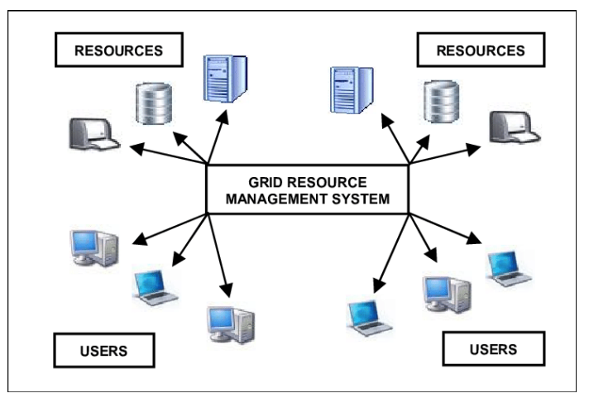
Introduction
Network of computing or processor machines managed by a middleware in order to access and use the resource remotely.
The managing activity of grid resource through the middleware is called grid services. .
Notes:
Can work together to solve a problem

Slide 25
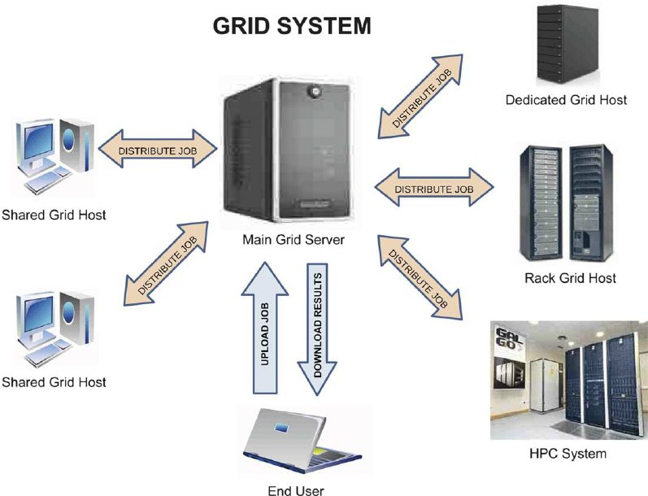
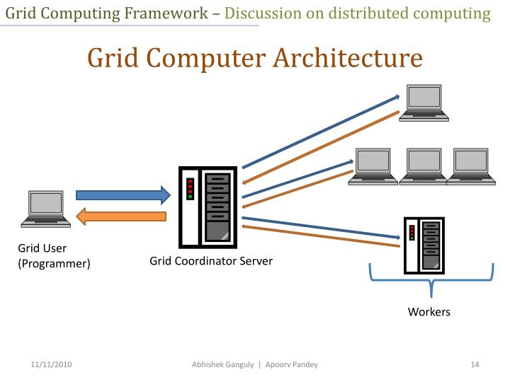
Grid computing
More info
Notes:
https://www.youtube.com/watch?v=r8ylJ16B0KQ

Slide 26
Grid computing
Characteristics
Large Scale
Resource Sharing
Deal with a number of resources ranging from just a few to millions. .
resources in a grid belong to many different organizations that allow other organizations to access them.
Geographical distribution
Multiple Administration
grid’s resources may be located at distant places.
each organization may establish different security and administrative policies under which their owned resources can be accessed and used
Heterogeneity
a grid hosts both software and hardware resources that can be very varied ranging from data, files, software components or programs to sensors, scientific instruments, display devices, personal digital organizers, computers, super-computers and networks.
Resource Coordination
resources in a grid must be coordinated in order to provide aggregated computing capabilities
Notes:
workloads can be scaled up or down depending on need. With a robust internet connection, HPC can be accessed from anywhere on the globe.

Slide 27
Grid computing
Characteristics
Pervasive Access
Dependable Access
the grid must grant access to available resources by adapting to a dynamic environment in which resource failure is commonplace.
a grid must assure the delivery of services under established Quality of Service (QoS) requirements. The need for dependable service is fundamental since users require assurances that they will receive predictable, sustained and often high levels of performance.
Transparent Access
a grid should be seen as a single virtual computer.
Consistent Access
a grid must be built with standard services, protocols and inter-faces thus hiding the heterogeneity of the resources while allowing its scalability
Notes:
workloads can be scaled up or down depending on need. With a robust internet connection, HPC can be accessed from anywhere on the globe.

Slide 28
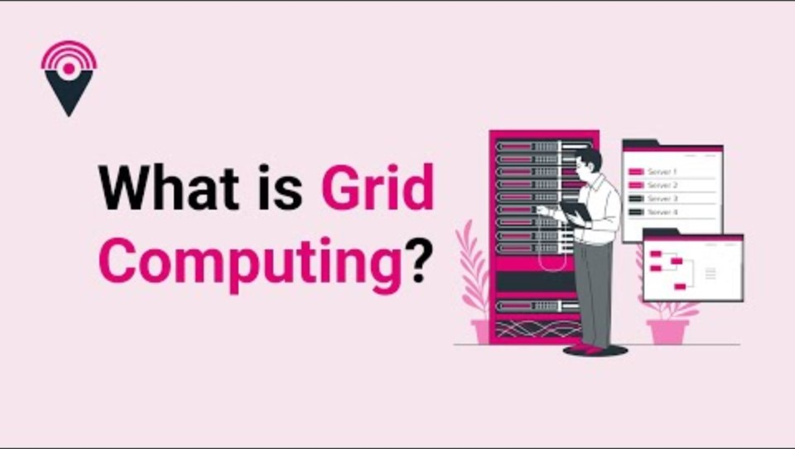
Computing

Slide 29

Computing

Slide 30
06
Cloud Computing
2022

Slide 31
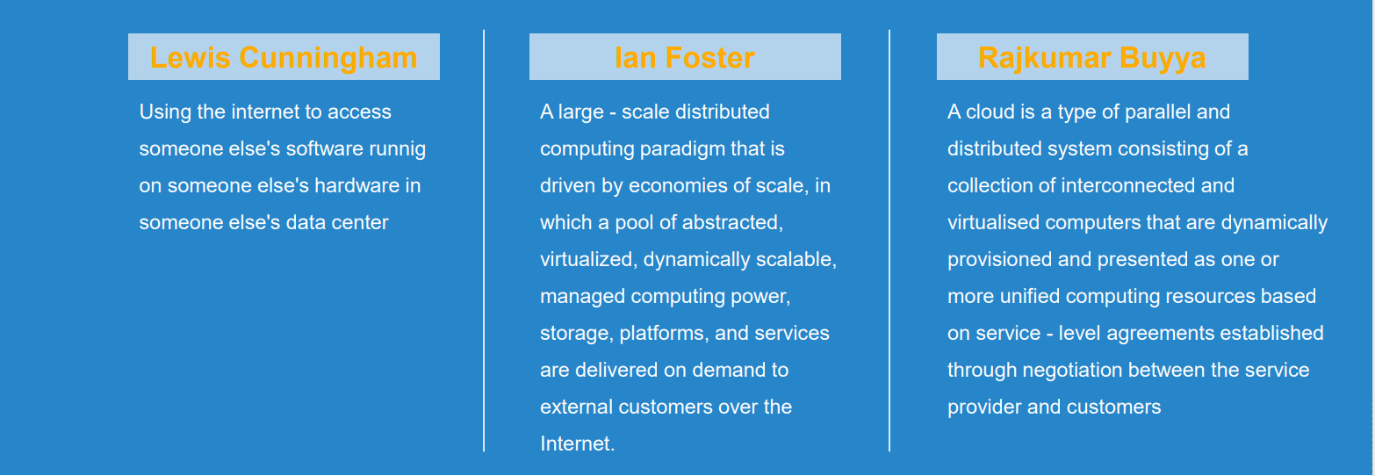
Introduction
Notes:
Can work together to solve a problem

Slide 32
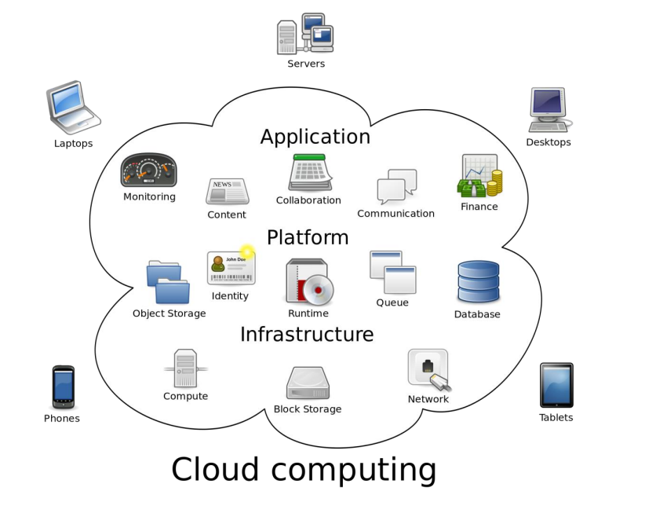
Introduction
Notes:
Can work together to solve a problem

Slide 33
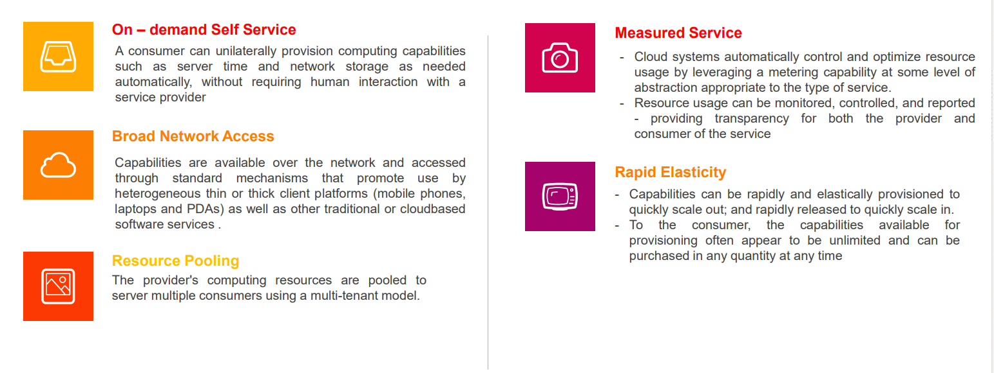
Cloud computing
Characteristics
Notes:
workloads can be scaled up or down depending on need. With a robust internet connection, HPC can be accessed from anywhere on the globe.

Slide 34
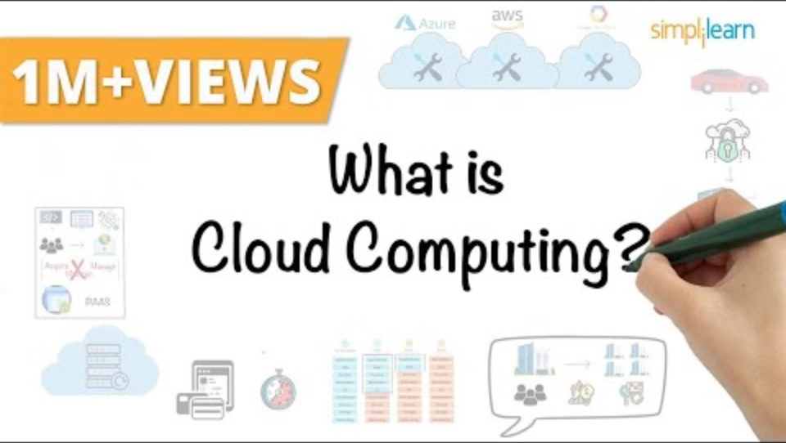
Computing

Slide 35
07
Mobile Computing
2022

Slide 36
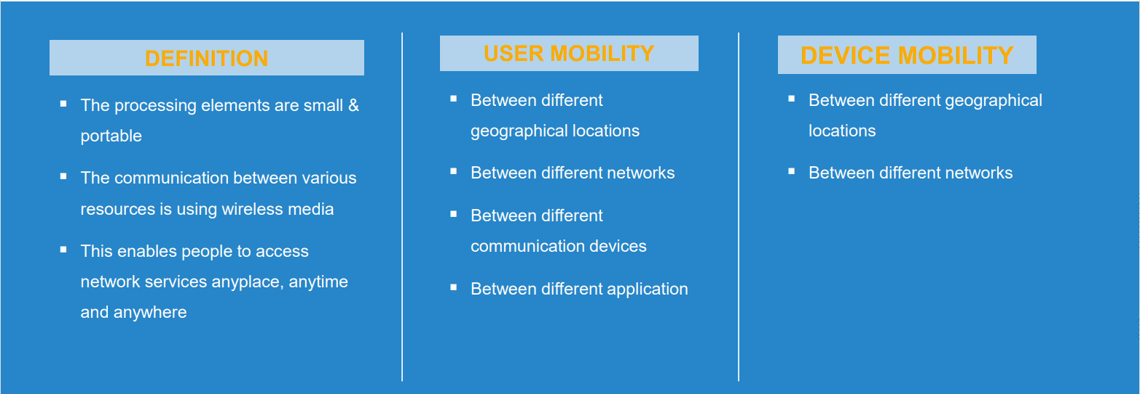
Introduction
Notes:
Can work together to solve a problem

Slide 37
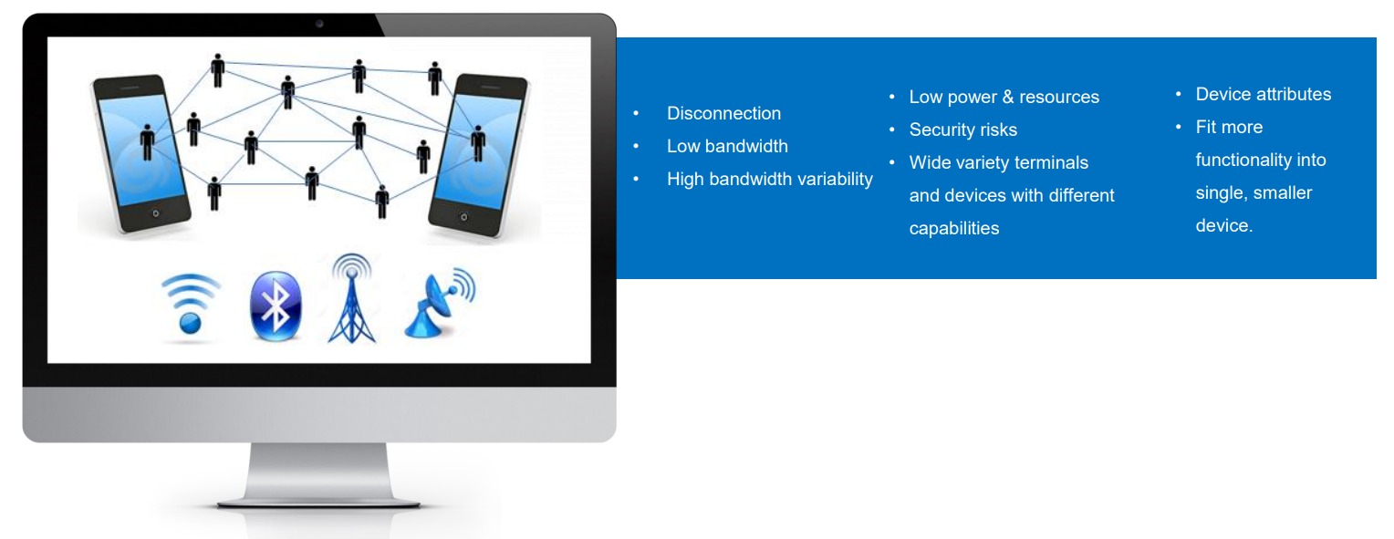
Mobile computing
Challenges
Notes:
workloads can be scaled up or down depending on need. With a robust internet connection, HPC can be accessed from anywhere on the globe.

Slide 38
08
Network Computing
2022

Slide 39
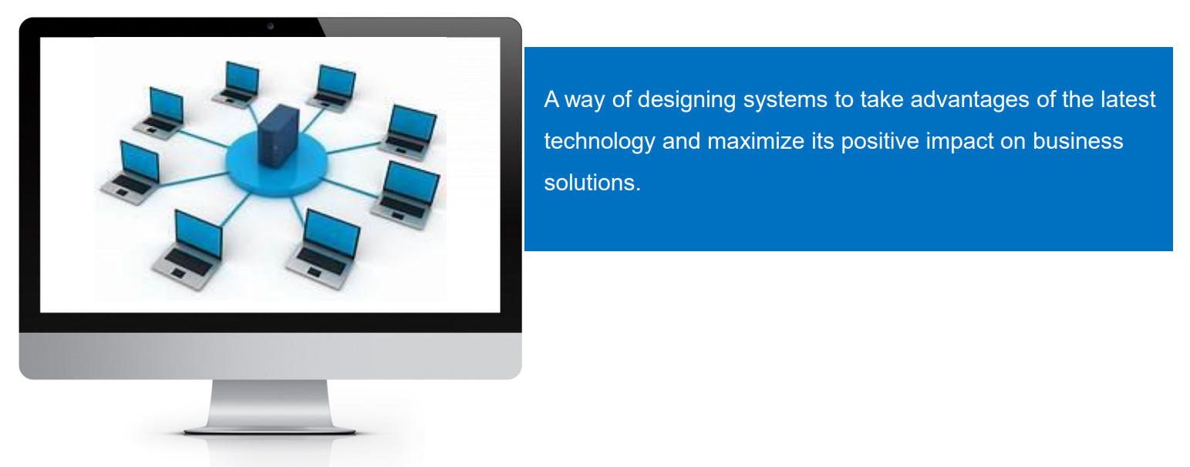
Introduction
Notes:
Can work together to solve a problem

Slide 40
Thanks
If you have any questions,
do not hesitate to email to me at:phuongttn@hcmute.edu.vn

